Slide 1

ECE 2001 Basic Circuit Theory
Lecture 8
Part I. AC Power Analysis

Slide 2
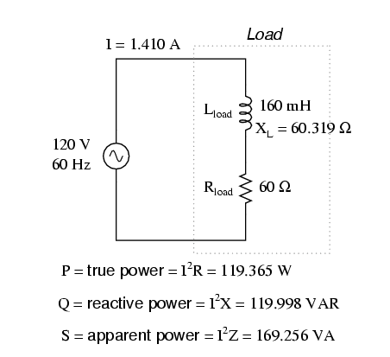
The fundamental questions for this topic
What is the power delivered to the load?
  Note that inductors and capacitors store energy
What is the efficiency for the source to deliver to the power to the load?
How can we improve the efficiency?
What’s new?
  The power is now time-varying.
  Voltage and current may not be in phase.

Slide 3
This lecture focuses on power calculations for sinusoidal steady-state circuits
Concepts of
  RMS values (effective values) of voltage, current
  Complex power, apparent power, real power, reactive power
  Power factor
Maximum power transfer
Techniques / tools
  Power triangle

Slide 4
Instantaneous Power
In general:
Therefore, the instantaneous power is:
  Note that this has two components. One is constant, depending on the phase difference between the voltage and current
  The other is sinusoidal with a frequency twice that of the voltage and current.
Recall

Slide 5
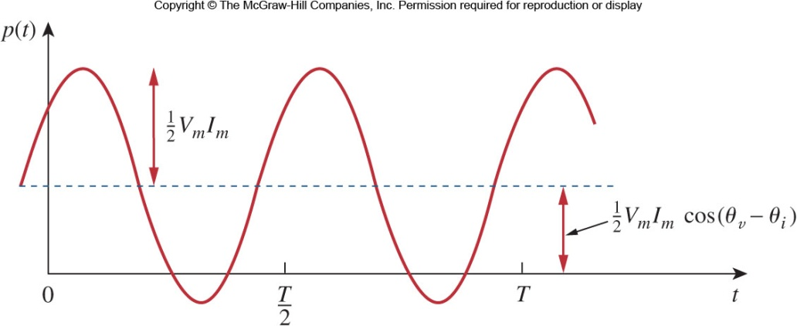
Instantaneous Power II
Note that there are times where the power goes negative, possible with circuit elements like inductors or capacitors which can store and release energy.
When current and voltage are out of phase, there will be negative power in the cycle.
To show instantaneous power, an oscilloscope is required.
A sketch of the instantaneous power.

Slide 6
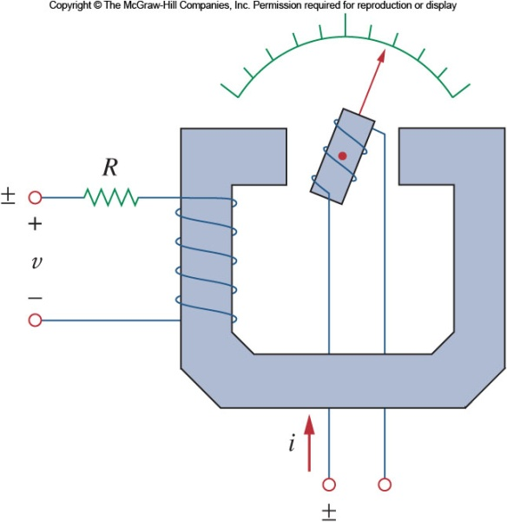
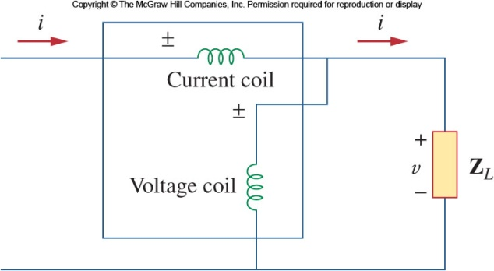
Measuring the AC Power: Wattmeter
Power consumption in a AC system can be measured using a Wattmeter.
The meter consists of two coils:
  The current coil – designed with low impedance and is connected in series with the load.
  The voltage coil – designed with very large impedance and is connected in parallel with the load.
The mechanical inertia of the moving system produces a deflection angle that is proportional to the average power.

Slide 7


Average Power
The instantaneous power changes with time and is therefore difficult to measure. The average power is more convenient to measure.
It is given by:
  The time independent part of the instantaneous power integrates to a constant.
  The time dependent part is a sinusoid and thus averages to zero.
The average power can be negative, if the phase difference is in the 2nd or 3rd quadrant (when cos(x) <0 which only happens with negative resistance cases)
The average power, is the average of the instantaneous power over one period.

Slide 8



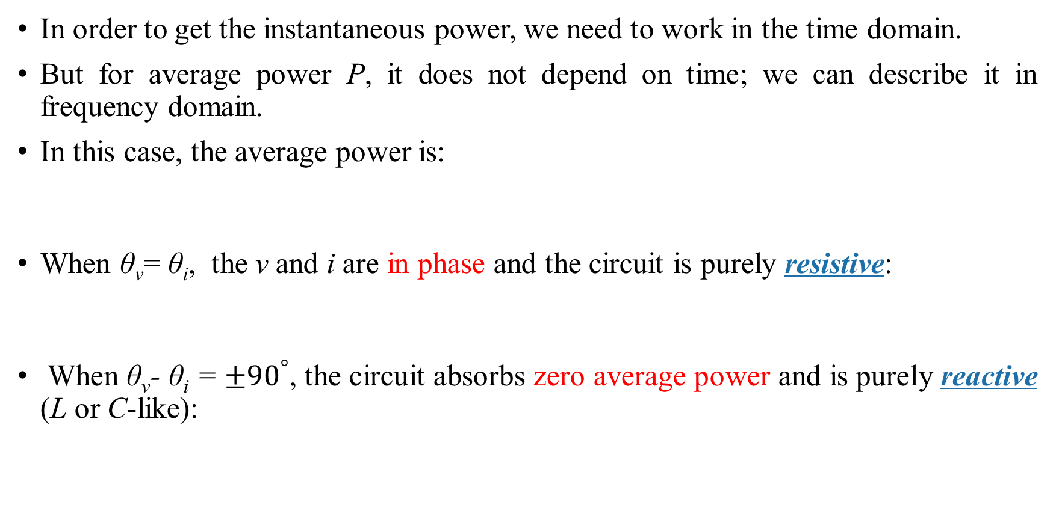
Average Power II
In order to get the instantaneous power, we need to work in the time domain.
But for average power P, it does not depend on time; we can describe it in frequency domain.
In this case, the average power is:
When θ_{v}= θ_{i}, the v and i are in phase and the circuit is purely resistive:
When θ_{v}- θ_{i} = $±{90}^{°}$, the circuit absorbs zero average power and is purely reactive (L or C-like):
$$\vec{I}$$
where ${\left|\overset{⃑}{I}\right|}^{2}=\overset{⃑}{I}×{\overset{⃑}{I}}^{∗}$

Slide 9
Effective Values
When a time varying source is delivering power to a resistive load, we often want to know the effectiveness of that source on delivering power.
This value is the DC current that delivers the same average power to a resistor as the periodic current.
For a periodic current, the average power absorbed is:
Equating these two and solving for the effective DC current yields:
The effective voltage is found in a similar manner:

Slide 10
RMS Value
The effective values for both current and voltage take the form of the square root of the average of the square of the periodic signal.
This is typically referred to as the root mean square, or RMS, value for short.
This can be extended to any periodic function, regardless of its shape:
However, for a sinusoidal waveform, the RMS value is related to the amplitude:
A special power can be determined from either RMS current or voltage:

Slide 11

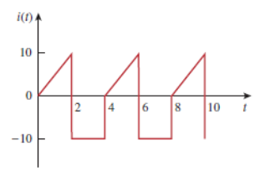
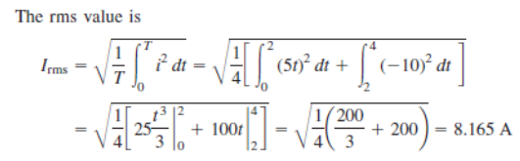

Example 1
Determine the RMS value of the current signal as shown below. If the current is passed through a 2Ω resistor, find the average power absorbed by the resistor.
The period of the waveform is T=4

Slide 12
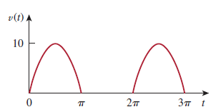
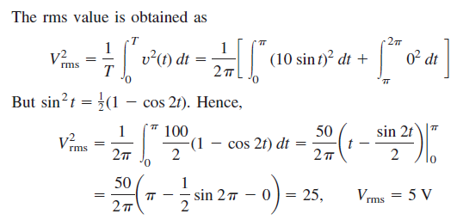


Example 2
The waveform is a half-wave rectified sine wave. Find the RMS value and the amount of average power dissipated in a 10Ω resistor
The period of the waveform is T=2π

Slide 13


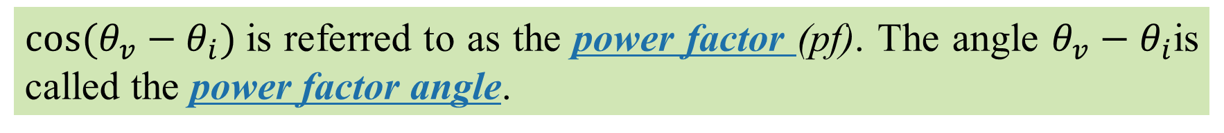
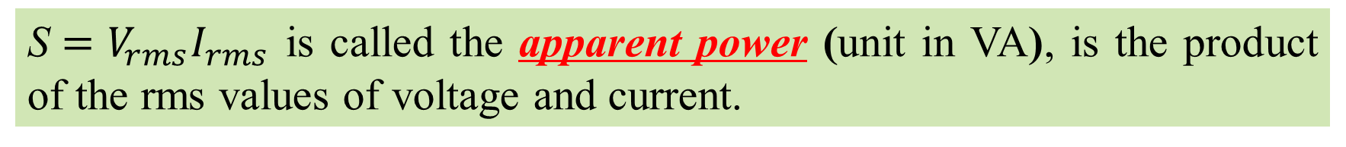
Apparent Power, Power Factor, and Power Factor Angle
(for sinusoidal circuits)
The average power which may be expressed in terms of RMS voltage and current, and it can be written as a product of two terms.
$\text{S}=V_{rms}I_{rms}$ is called the apparent power (unit in VA), is the product of the rms values of voltage and current.
$\cos{(θ_{v}−θ_{i})}$is referred to as the power factor (pf). The angle $θ_{v}−θ_{i}$is called the power factor angle.

Slide 14

Apparent Power
$$\text{S}=V_{rms}I_{rms}$$
The apparent power is so called because it seems apparent that the power should be the voltage-current product, by analogy with dc resistive circuits.
The unit of apparent power is (VA), to distinguish it from the average or real power, which is measured in watts (W).
Note: For a resistive load, the apparent power is the average power (S=P); for a general load (impedance), it is not (S≠P).

Slide 15
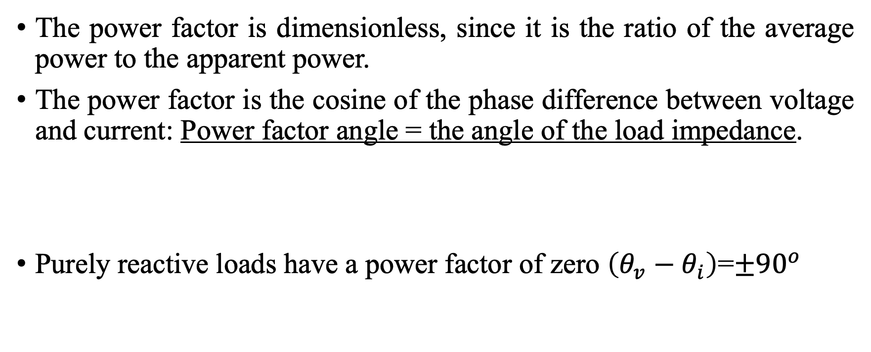
Power Factor and Power Factor Angle
The power factor is dimensionless, since it is the ratio of the average power to the apparent power.
The power factor is the cosine of the phase difference between voltage and current: Power factor angle = the angle of the load impedance.
Purely reactive loads have a power factor of zero $\left(θ_{v}−θ_{i}\right)$=$±{90}^{o }$

Slide 16

Complex Power
The term complex power is used to find the total power effect of loads. Complex power is important in power analysis because it contains all the information pertaining to the power absorbed by a given load.
It is a complex number, where its magnitude is the apparent power; hence it is measured in volt-amperes (VA) too.
$$\overset{⃑}{S}=V_{rms}I_{rms}∠\left(θ_{v}−θ_{i}\right)$$
$$=V_{rms}I_{rms}\cos\left(θ_{v}−θ_{i}\right)+jV_{rms}I_{rms}\sin\left(θ_{v}−θ_{i}\right)$$

Slide 17
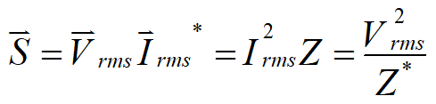



Complex Power
Resistive load: Q=0 (unit pf); capacitive load (leading pf): Q<0, inductive load (lagging pf): Q>0.
$$\overset{⃑}{S}=V_{rms}I_{rms}\cos\left(θ_{v}−θ_{i}\right)+jV_{rms}I_{rms}\sin\left(θ_{v}−θ_{i}\right)$$
This may also be expressed in terms of the RMS values and load impedance as:
So in rectangular form:
where Z = R+jX is the impedance
P is the average or real power:
Q is called reactive (or quadrature) power:

Slide 18

Real and Reactive Power
The real power P is the average power in watts delivered to a load; it is considered as the useful power, which is the actual power dissipated by the load.
The reactive power Q is a measure of the energy exchange rate between the source and the reactive part of the load; its unit is volt-ampere reactive (VAR) to distinguish it from the real power.
Q=0 for resistive loads (unity pf)
Q<0 for capacitive loads (leading pf)
Q>0 for inductive loads (lagging pf)
Notes:
We don’t require the concept of leading or lagging power factor. However, make sure to understand the concept of capacitive load and inductive load.

Slide 19
Reactive Power Q
We know that reactive loads such as inductors and capacitors DO NOT dissipate power, yet the fact that they drop voltage and draw current gives the deceptive impression that they actually dissipate power. This “phantom power” is called reactive power, and it is measured in a unit called Volt-Amps-Reactive (VAR), rather than watts.
Real or True Power P
The actual amount of power being used, or dissipated, in a circuit is called real power, and it is measured in watts.
Apparent Power S
The combination of reactive power and real power is called apparent power, and it is the product of a circuit’s voltage and current, without reference to phase angle. Apparent power is measured in the unit of Volt-Amps (VA)

Slide 20
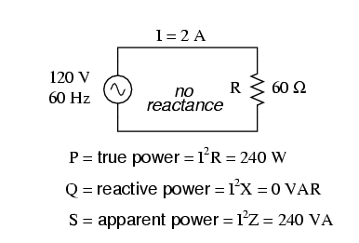
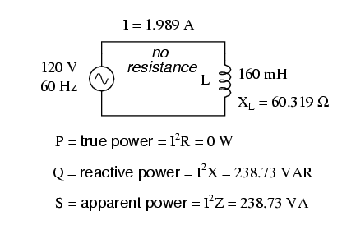
(all values are RMS values)

Slide 21
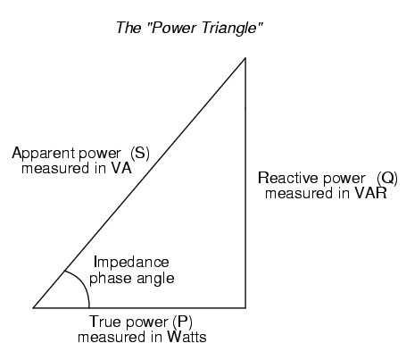
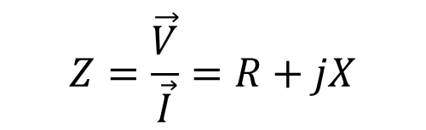

The power triangle
$$Z=\frac{\vec{V}}{\vec{I}}=R+jX$$
Recall the impedance
The impedance phase angle will be the same as in the power triangle.
$$θ=\tan^{−1}{\frac{X}{R}}$$
If reactance is +ve, the phase angle is +ve, and Q is +ve, corresponding to inductive impedance.
If reactance is –ve, the phase angle is –ve, and Q is –ve , corresponding to capacitive impedance.
Real power (P)
Measured in Watts

Slide 22
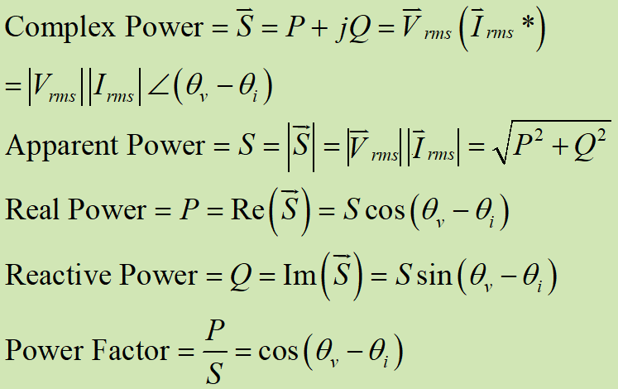

Summary
$$\frac{1}{2}\overset{⃑}{V}({\overset{⃑}{I}}^{∗})$$
Power & Impedance triangle

Slide 23
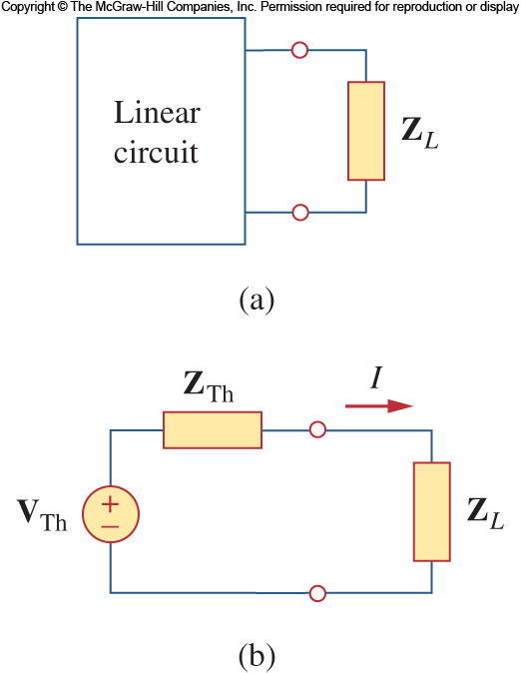
Maximum Average Power Transfer
Previously we considered how to maximize power delivered to a resistive load: It was shown that maximum power was transferred when the load resistance is equal to the Thévenin resistance of the supply circuit.
This will now be extended to AC circuits.
The Thévenin impedance and load impedance can be written as
The current through the load is:

Slide 24



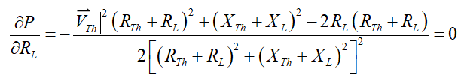
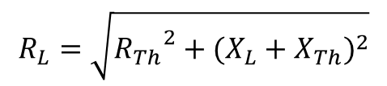

Maximum Average Power Transfer
The average power delivered to the load is:
For a given source, the average power P depends on R_{L} and X_{L} (a function of two independent variables). Therefore, to maximize P, we must find the values where both partial derivatives are zero
Combing both, when both derivatives are zero, we have
$$R_{L}=\sqrt{{R_{Th}}^{2}+{(X_{L}+X_{Th})}^{2}}$$
$$X_{L}=−X_{Th}$$
and
The load impedance = the complex conjugate of the Thévenin impedance

Slide 25
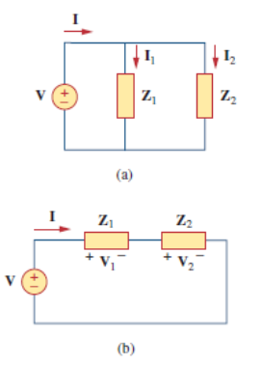
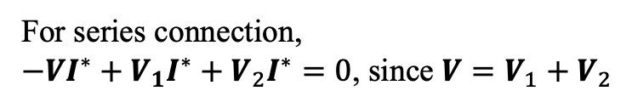
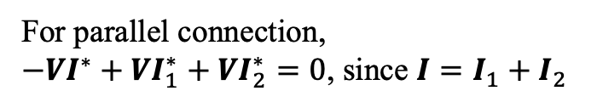
Conservation of AC Power
Regardless of how circuit elements are connected, the complex power of the sources equals to respective sums of the complex powers of the individual loads. (The same is true of real and reactive power, but not of apparent power.)
For parallel connection,
$−VI^{∗}+VI_{1}^{∗}+VI_{2}^{∗}=0$, since $I=I_{1}+I_{2}$
For series connection,
$−VI^{∗}+V_{1}I^{∗}+V_{2}I^{∗}=0$, since $V=V_{1}+V_{2}$

Slide 26

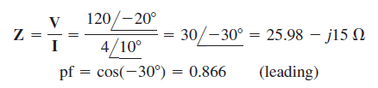



Example 3
A load draws a current $i\left(t\right)=4\cos{(100πt+{10}^{°})}$ when the applied voltage is $v\left(t\right)=120\cos{(100πt−{20}^{°})}$. Find the apparent power and the power factor of the load. Determine the element values that form the load.
The apparent power is :
30cos30º
The power factor is :
30º
30sin30º
The pf can also be obtained as
30
The load can be modeled as a 25.98 Ω resistor in series with a capacitor

Slide 27
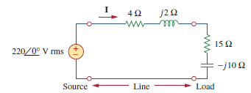





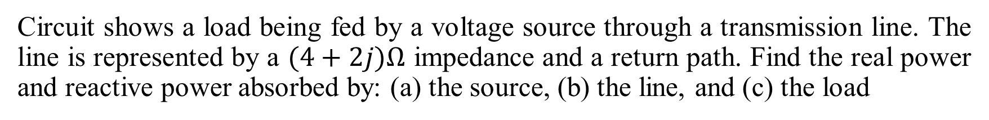
Example 4
Circuit shows a load being fed by a voltage source through a transmission line. The line is represented by a $(4+2j)Ω$ impedance and a return path. Find the real power and reactive power absorbed by: (a) the source, (b) the line, and (c) the load

Slide 28
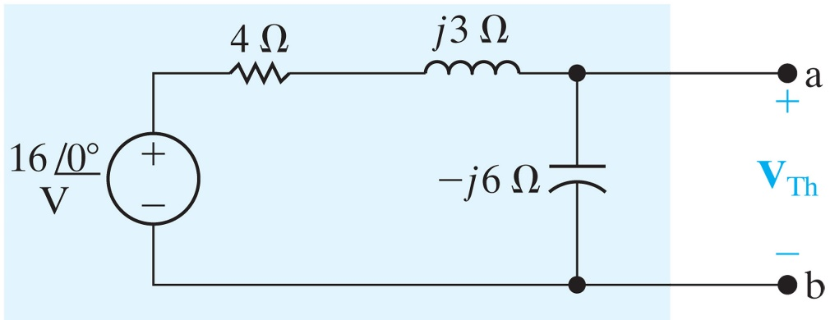
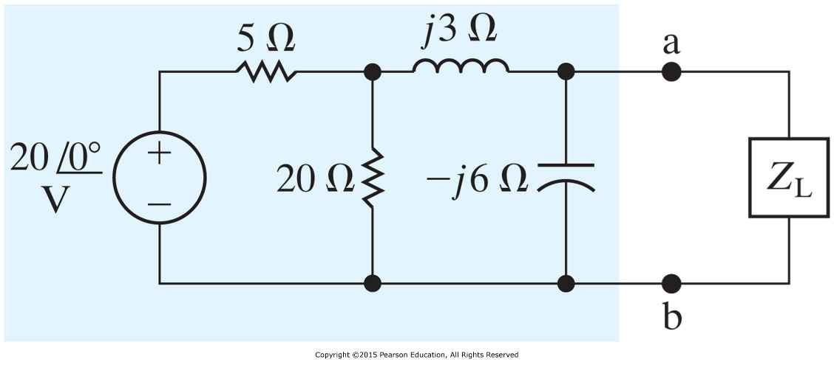
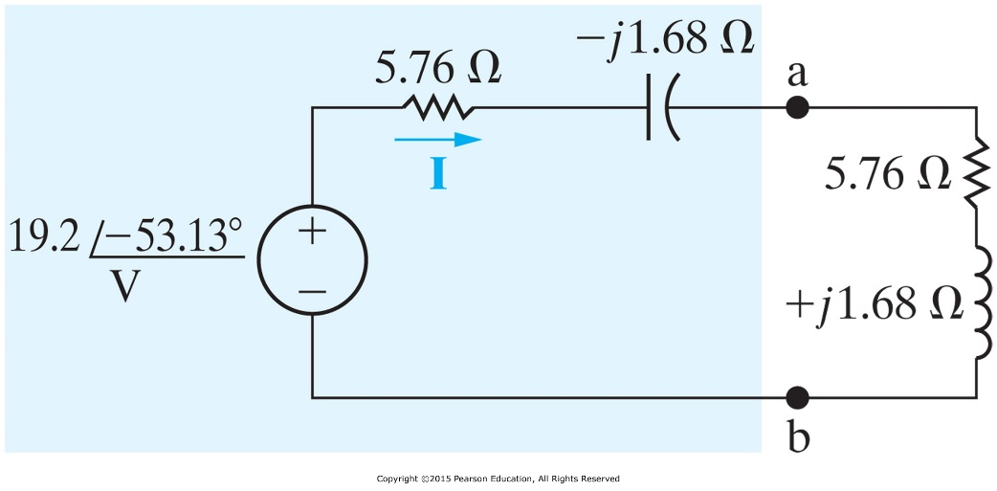
Example 5
Determine the impedance Z_{L} that maximizes the average power transferred to the load.
Z_{Th}
Equivalent to figure out the Thévenin Equivalent Circuit.
V_{Th}

Slide 29
Expected learning outcome
Understand the concepts and be able to compute the quantities of
  RMS values (effective values) of voltage, current, and power
  Complex power, apparent power, real power, reactive power
  Power factor
Be able to apply these concepts as well as relevant tools to compute the desired load impedance for maximum power transfer from the power source

